Slide 1


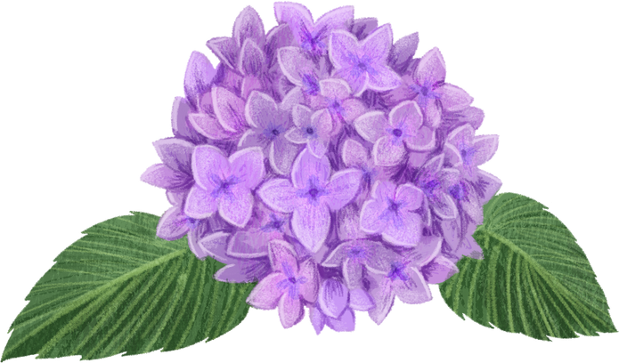

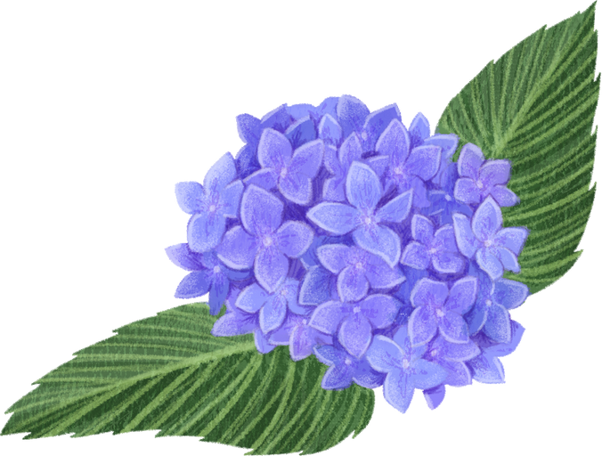
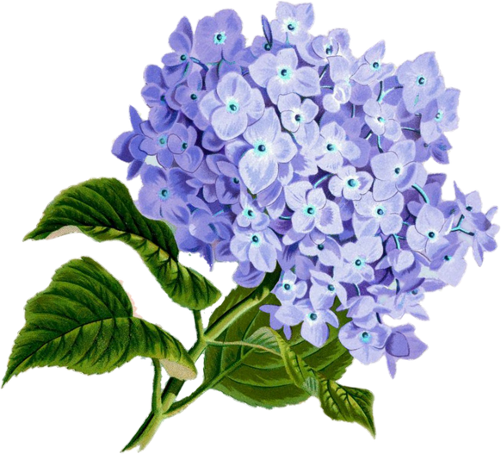
Diatomaceous Earth for Gardening - Benefits & How to Use It

Slide 2
Keeps pests away,
including slugs, aphids, and ants.

Slide 3
Helps prevent fungal diseases
like powdery mildew.

Slide 4
Improves soil quality,
enhancing aeration and moisture retention.

Slide 5
Natural and safe,
won’t harm plants or soil.

Slide 6
Easy to apply
- sprinkle by hand or use a sifter for even coverage.

Slide 7
Important! Reapply after rain,
as moisture reduces its effectiveness.

Slide 8
  Keeps pests away, including slugs, aphids, and ants.
  Helps prevent fungal diseases like powdery mildew.
  Improves soil quality, enhancing aeration and moisture retention.
  Natural and safe, won’t harm plants or soil.
  Easy to apply - sprinkle by hand or use a sifter for even coverage.
  Important! Reapply after rain, as moisture reduces its effectiveness.
Hydrangealibrary.com

Slide 9

Tip: If used in excess, it may slightly increase soil alkalinity, which could affect plants like blue hydrangeas.

Slide 10

Any Question?
Ask your questions in the comments!

Slide 11
Thank You
by Hydrangealibrary.com

